Slide 1
SAP Trial Account Set Up
https://developers.sap.com/tutorials/hcp-create-trial-account.html

Slide 2

SAP Integration Suite

Slide 3
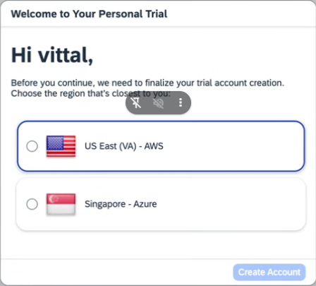
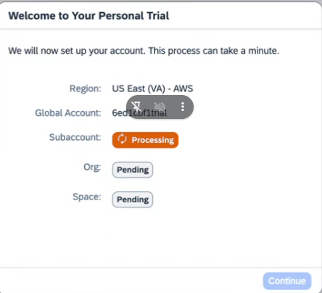
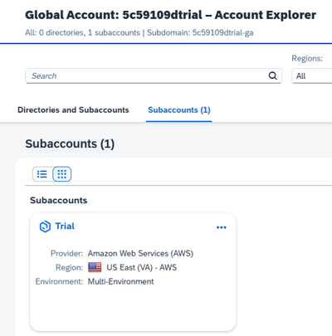
TRIAL ACCOUNT CREATION STEPS
Go to https://cockpit.hanatrial.ondemand.com/. Select the region
Now this will create Global Trial Account and SubAccount.
Click on subAccount

Slide 4
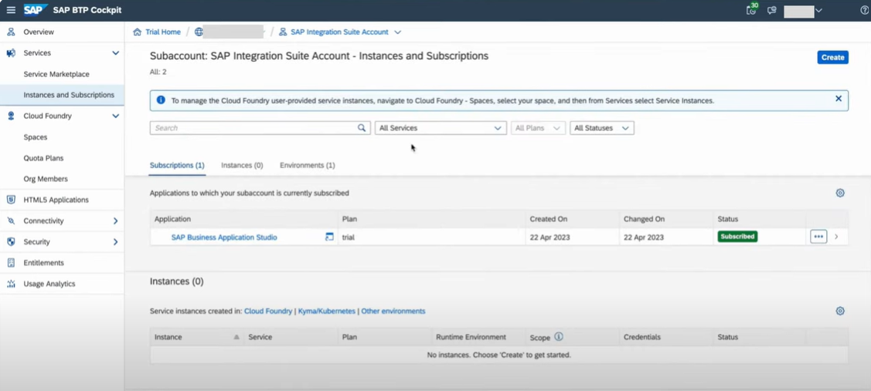
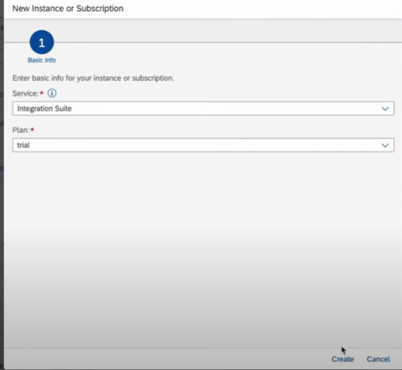
TRIAL ACCOUNT CREATION STEPS
Go to Sub account and now Click On Create
Now We need to select Service as Integration Suite
Plan as Trial
Click On Create

Slide 5
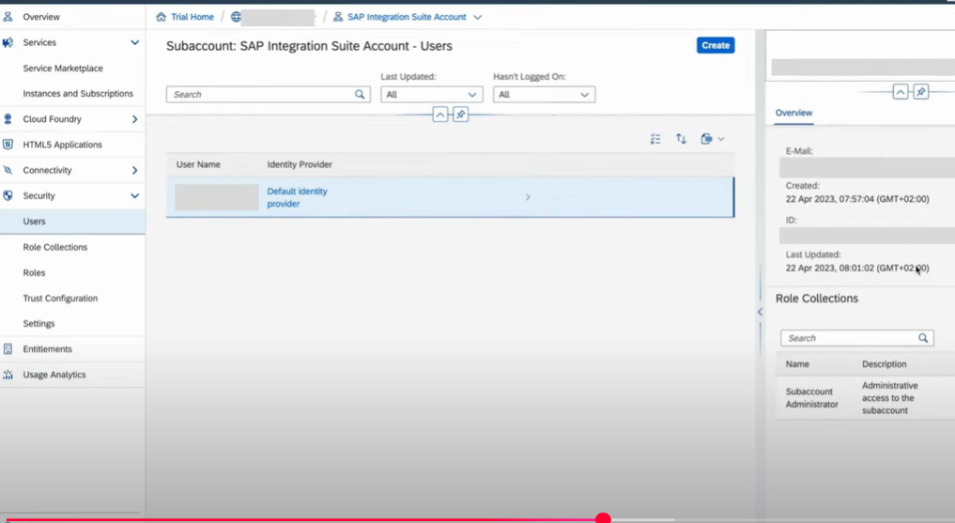
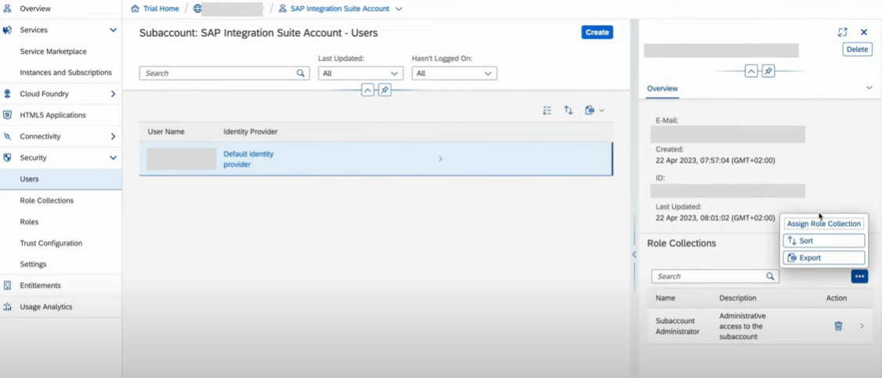
Now Go to Users
Because we need to users and permissions here
It is called as user Access Management for Integration Suit
Now Go to Role Collection and Assign Role Collection

Slide 6
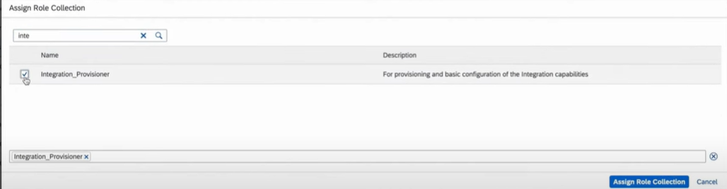
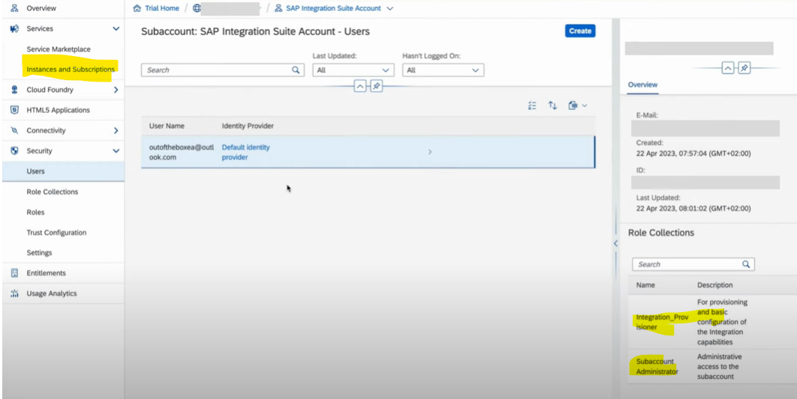
Now Here we need to Add role called Integration_Provisioner
Click On Assign Role Collection
Now Go back To Instances & Subscriptions

Slide 7
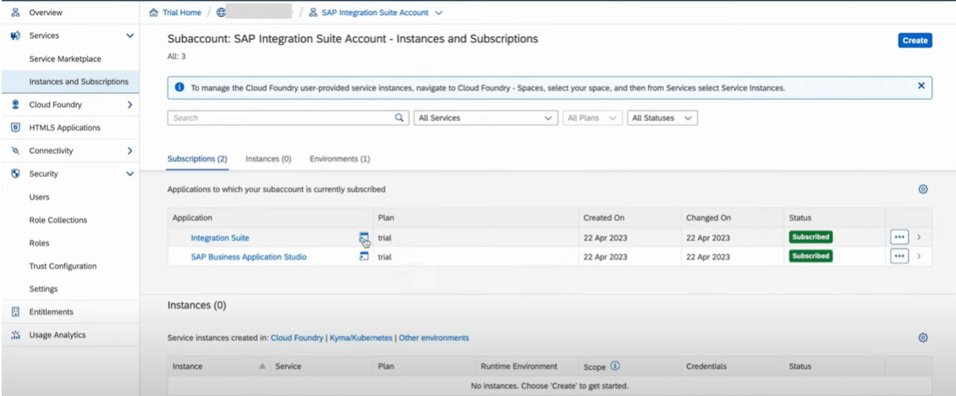
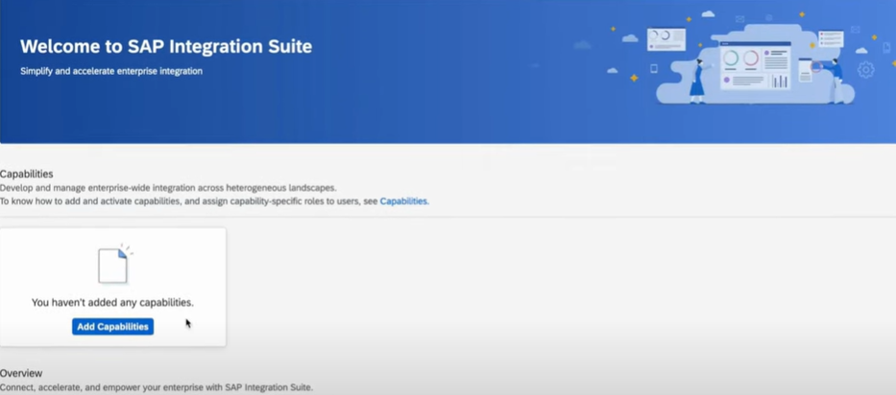
Now Click On Integration Suit Tab
Which will redirect us to Application
Now We need to add all Capabilities

Slide 8
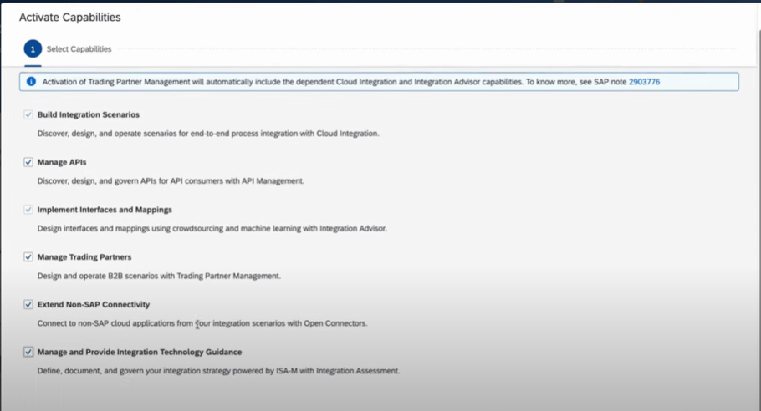
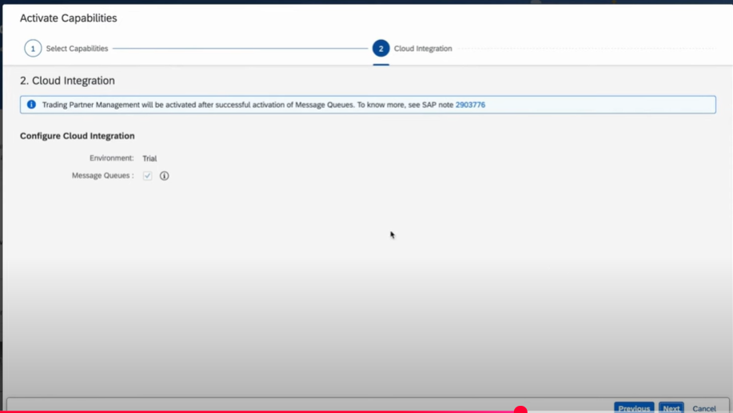
Now Add Build Integration Scenarios and Manage API’s capabilities.
Click On Next

Slide 9
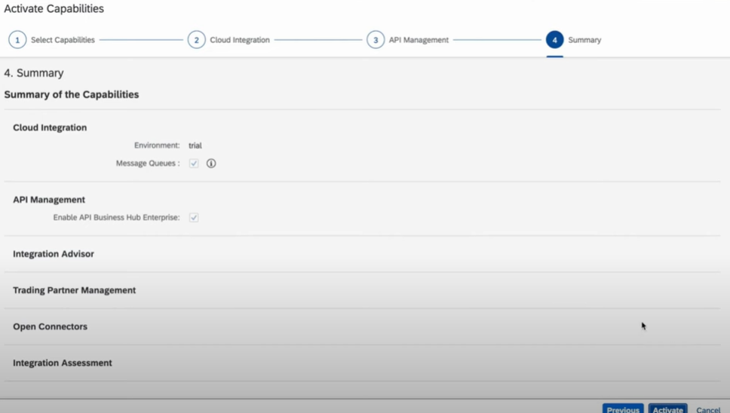
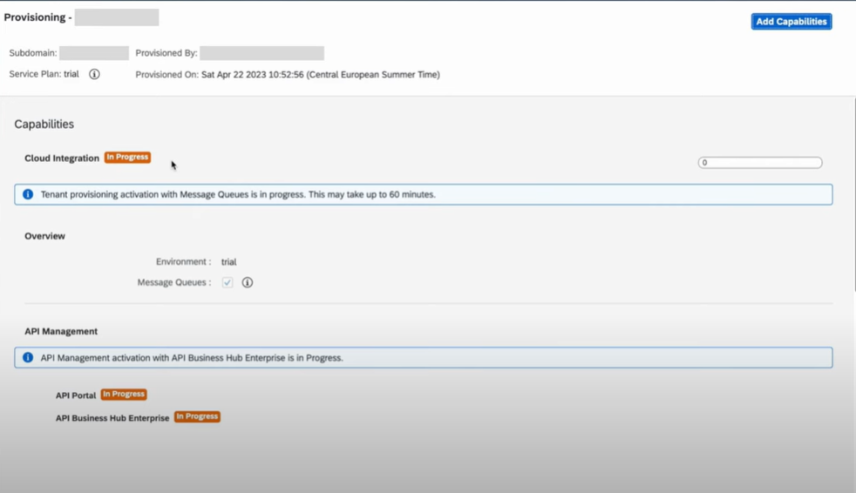
Click On Next and Activate
Now Its Going To Active Everything

Slide 10
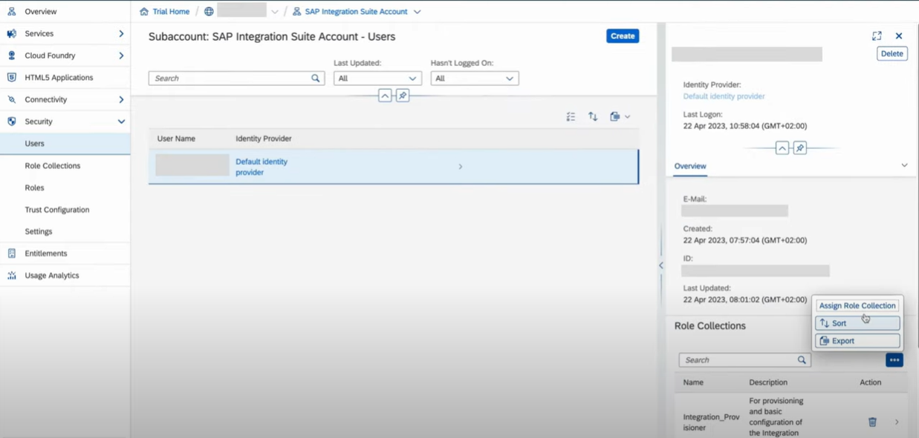
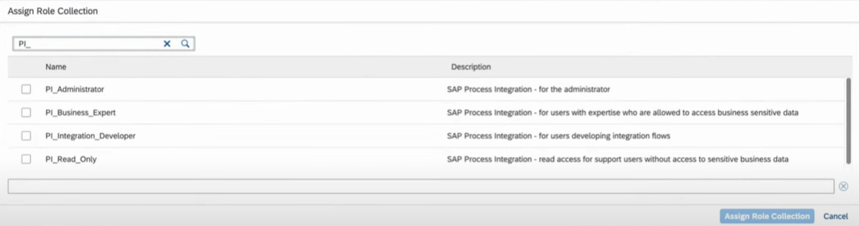
Again Security🡪 Go Back To Users🡪Go To Role Collection🡪Assign Role Collection
Now we need to assign the roles for CPI and APIM.

Slide 11
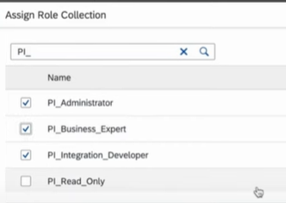
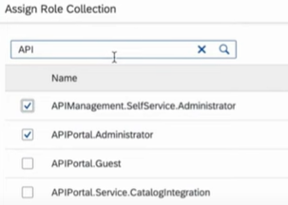
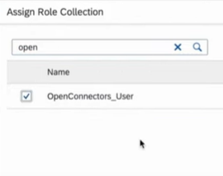
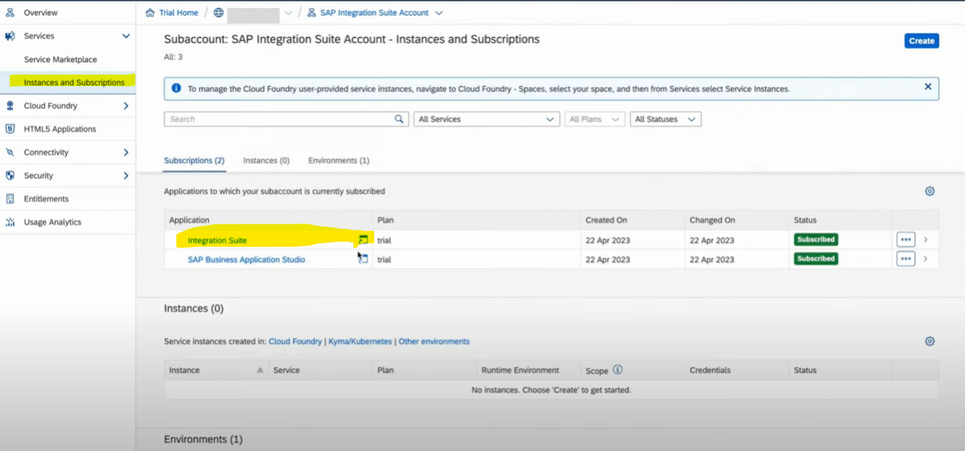
These all roles need to be added , Now Click On OK
Now Go Back to Instance and Subscriptions
Click on Integration suit Application button

Slide 12
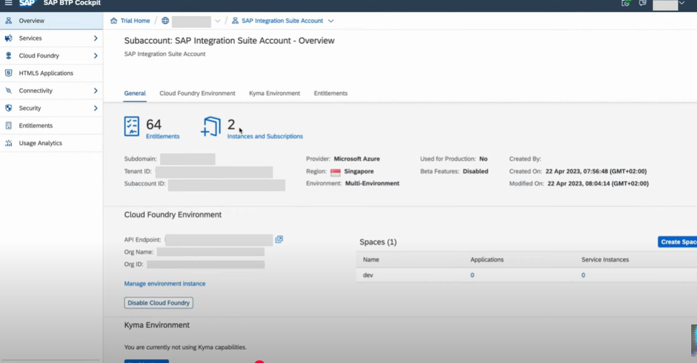
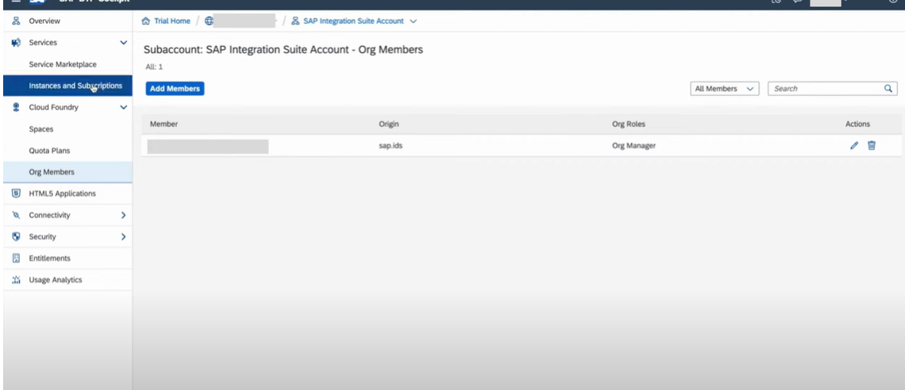
When you click on trail you can see this page
Now We need to go to services and click on instance and Subscriptions

Slide 13
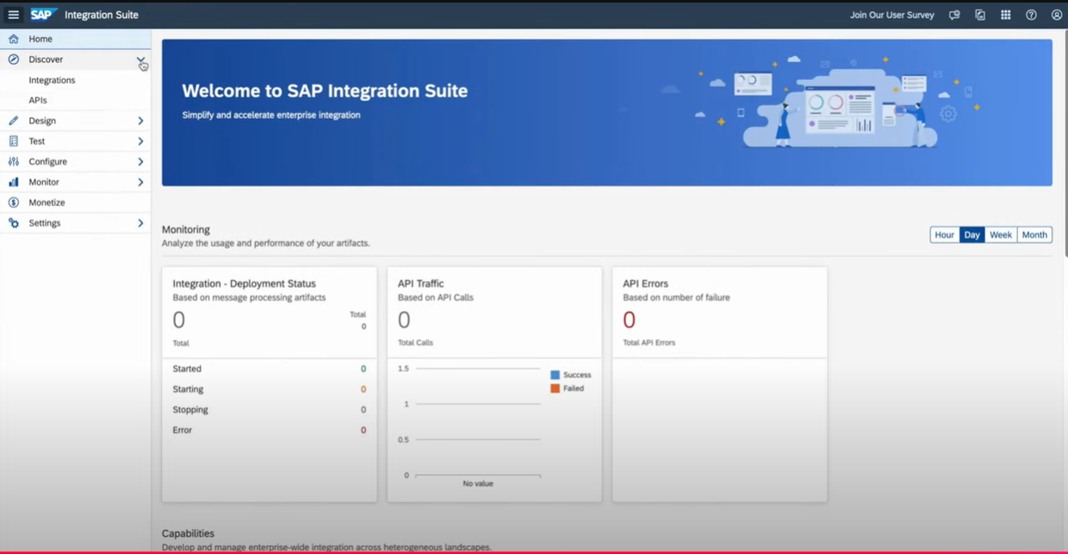
Now You Can See Components Of SAP CPI

